Slide 1
Open Data: Infrastructure, Innovation, Literacy
Johanna Walker
PhD Student, Web Science Centre for Doctoral Training
12/12/16

Slide 2
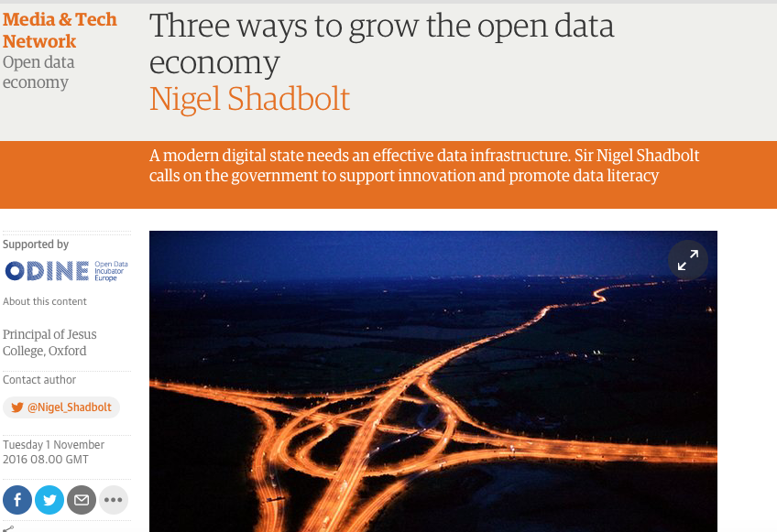
Three ways to grow Open Data

Slide 3
OKF: Three principles of ‘open’
Availability and Access: that people can get the data
(Infrastructure)
Re-use and Redistribution: that people can reuse and share the data (Innovation)
Universal Participation: that anyone can use the data
(Data Literacy)

Slide 4
1. Data Infrastructure
“Our data infrastructure is a core part of our national infrastructure. From lists of legally constituted companies to the country’s geospatial data, our data infrastructure needs to be managed, maintained, in some cases built and in all cases made as widely available as possible.”
Availability and Access: that people can get the data

Slide 5
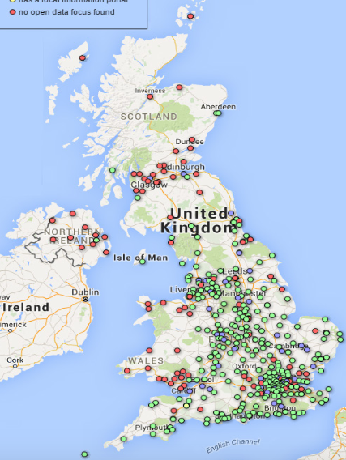
Where is our open government data?

Slide 6
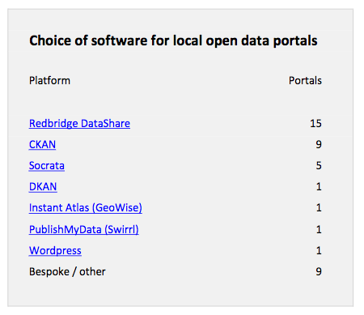
How are Local Authorities publishing data?

Slide 7
National Information Infrastructure
The NII is a management framework for the most strategically important data held by government. It is composed of:
a set of guiding principles
a curated list of the most strategically important data
a governance structure
baseline quality criteria
(Coalition Government)
https://www.gov.uk/government/uploads/system/uploads/attachment_data/file/416472/National_Infrastructure_Implementation.pdf

Slide 8
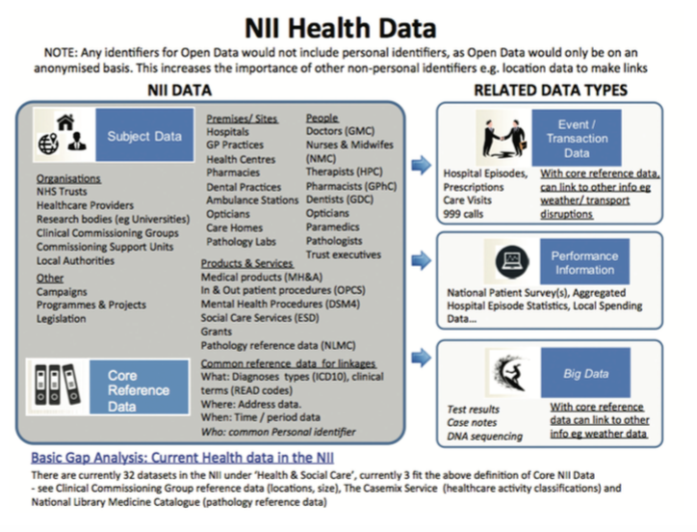
The NII – What, Why, How?

Slide 9
National Information Infrastructure (ODUG)
Linked data is vital for (re)useability
Unique identifiers
Tools and products for (re)using data need to be co-located with datasets
Raw data and versioned data should be provided
Can support commercial data eg belonging to transport companies
From Public Sector Information Catalogue to Productive Data: Defining a National Information Infrastructure
Walker, J, Taylor J and Carr, L (2015)
Fighting Phantom Firms in the UK: From Opening Up Datasets to Reshaping Data Infrastructures?
Gray, J and Davies, T (2015)

Slide 10
Data quality issues for infrastructure
‘Cleanliness’ of data is valued above all
This may reduce usefulness; privilege certain datasets over others
This may reinforce status quo and reduce creation of socially useful products, especially in niche or minority functions
This may reduce the creation of knowledge
Hackathons, data and discourse: Convolutions of the data (logical)
Thornham, H and Gómez Cruz, E (2016) Big Data and Society

Slide 11
2. Data Innovation
“If we are to make best use of data, we need a bridge between academic research, public, private and third sectors, and a thriving start-up ecosystem where new ideas and approaches can grow.”
Re-use and Redistribution: that people can reuse and share the data

Slide 12
$3tn Data: User Innovation and Open Data
Exploring the potential for entrepreneurial innovation of open data products and services

Slide 13
Benefits of Open Data
Transparency
Accountability
Participation
Efficiency
Social Value
Research Value
Economic Value

Slide 14
McKinsey (2013)
Increased Efficiency
New Products and Services
Consumer Surplus

Slide 15
Open Data Innovation
Lack of systematic measurement via impact metrics
Little understanding of how innovation occurs through Open Data activities
A recent study by NESTA suggested there was in fact surprisingly little innovation taking place utilising Open Data
GovLab’s stories of new economic impact focus on impact from a publication rather than an entrepreneurial point of view
ODINE
OpenData.Innovation: an international journey to discover innovative uses of open government data
Rubenstein M, Cowls, J and Cath, (2016) NESTA

Slide 16
Literature Review – Open Data
Mechanisms for Data Release
From Publishing to Usage
Sources of Conflict
Participation in Open Data
Value Chain
Data Literacy
Demand Stimulus

Slide 17
Literature Review: User Innovation
Agency Cost Reduction
Lack of Incentives
Lead Users
Benefits of Learning
Free Revealing
Heterogeneity of Need
User Innovation Communities

Slide 18
Literature Review: Open Source Communities
Describes successful communities of innovation
Identifies innovation in practice
Creates framework

Slide 19
Research Questions
RQ1: What kind of innovation is occurring in these communities?
RQ2: How are these user innovation communities creating demand for open data?
RQ3: Still working on that….

Slide 20
Open Data and Social Enterprise

Slide 21
3. Data Literacy
“In order to take advantage of the data revolution, policymakers, businesses and citizens need to understand how to make use of data. In other words, they must become data literate.”
Universal Participation: that anyone can use the data

Slide 22
Data Literacy State of the Art
https://www.youtube.com/watch?v=7BTkylI60DM&feature=player_embedded c 2.20 talking about Data Literacy
Journal of Community Informatics Special Issue on Data Literacy
ci-journal.net

Slide 23
Emerging Research – The DataWalk
Engaging citizens with their data creation, consumption and implications
Rural – reaction to SmartCities and urban domination of data
Three key questions:
What are you collecting
Why are you collecting it
How/how often are you collecting it

Slide 24
Some arising issues
Better understanding of what constitutes data: “I thought data was all zeros and ones”
Codeification of ‘local knowledge’ into data
Much data identified is collected, and it is an issue of dissemination and awareness
Geospatial data is dominant
How is data delivered in rural communities at point and time of use

Slide 25
If you’re interested in Open Data….
General
Open Data Handbook
Open Data Charter
Open Data Barometer
Open Data Index
Open Data 500
W3 Open Data
McKinsey Report
UK OGD
Open Data White Paper
Shakespeare Report
Research and Practical Activities
Web Foundation IDDC
International Open Data Conference Proceedings
Open Data Research Symposium
http://odimpact.org/resources.html
Zotero Reading Group (development)
http://odimpact.org/ Ebook ’Global impact of open data’
theodi.org

