Slide 1
Reporting Skills 1.
WEBS6202
Kieron O’Hara
31 January 2017
Notes:
Please use the dd month yyyy format for the date for example 11 January 2008. The main title can be one or two lines long.

Slide 2
What Does A Report Do?
Analyses a specific problem
Organises the issues and arguments systematically
  Evaluates significance
Communicates to an audience of non-experts
Recommends actions that:
  Are within the audience’s power
  Are pragmatic, feasible
  Address the problem as posed
  Grow out of the analysis

Slide 3
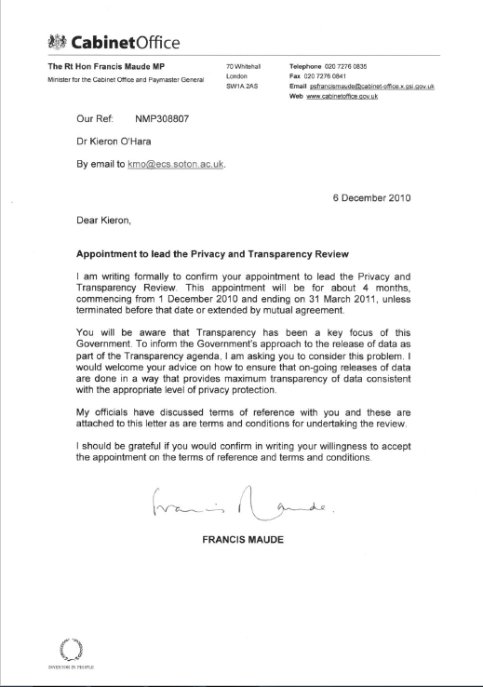
Scope
A topic
Terms of reference
  Timescale
  Remuneration/expenses
  Liability
  Hospitality/conflicts of interest
  Confidentiality
  Publication
Discussed in advance

Slide 4
Getting To Grips
Understand the material
Understand the needs of the client
Approach
  Literature review?
  Interviews?
  Surveys?
  Original research?
What can you afford? – money, time, man/womanpower

Slide 5
Structuring
Which ideas are central and which subsidiary?
Cluster the main ideas
  Linear thought process?
  Network of issues?
  Hierarchies?
  Mind maps?
How have others covered it?
  How can I go beyond this?
The presentation/structure is often your chief contribution

Slide 6
Within The Structure
Relevance
  Reject the marginal
Even treatment
  Give each main idea the treatment it deserves relative to the length of the report
What do I need to bone up on?
  Who do I need to talk to?
  Whose opinion is relevant?
  Who has an axe to grind?
Ethical standards

Slide 7
Content
Discussion
  Represent all sides
  Find commonalities
  Find divergence
Neutral or partisan?
  Everyone has a point of view
  Don’t pick fights
  Were you chosen for your special position?
Source everything
Conclusions
  Yes, no, maybe
  Recommendations

Slide 8
Recommendations
Do they address the problem?
Do they follow from your discussion?
  Include their justification
Will it be obvious to your client what to do?
  Are they within their gift?
Are they measurable? How would you declare success?
Warnings of costs and risks
Negotiate with clients
  Preliminary findings

Slide 9
Style
Clear, readable by a layperson
  No jargon
  No long, complex sentences
  Logical structure of paragraphs clear (not too many ‘howevers’, ‘yets’, ‘buts’)
  Not too many bulleted lists (good for conveying information, hard to read)
  Pronouns, tenses clear
Impersonal (usually)
Don’t show off
  Avoid jokes, literary allusions, wonderful imagery, slang, all references to Hegel
Be inclusive
  You may hate May/Corbyn/Trump, but your readers may not

Slide 10
Structure
Executive summary
  Max 2 pages – the only part most people will ever read
  Describe the headlines
  Include recommendations
Intro: problem spec, ToRs and method(s)
Analysis
Conclusions, recommendations and their justifications
Full acknowledgements and references
Glossary for a long report (especially abbreviations)
Appendices for data, detail, technical stuff which no-one will ever read

Slide 11
Reception
What does the client want to hear?
  Does the client care what a wider audience thinks?
  What is the post-publication strategy (e.g. Twitter)?
  The client shouldn’t be surprised at this stage
What do the stakeholders want to hear?
What do other actors in the space want to hear?
Do you go out on a limb or cater to the client?
  Blandness v marginalisation
Trigger words
  Risk, danger, problem

